Slide 1
A click chemistry amplified nanopore assay for ultrasensitive quantification of HIV-1 p24 antigen in clinical samples
March 30, 2023
Chunlin Min
Wei, X., Wang, X., Zhang, Z. et al. A click chemistry amplified nanopore assay for ultrasensitive quantification of HIV-1 p24 antigen in clinical samples. Nat Commun 13, 6852 (2022). https://doi.org/10.1038/s41467-022-34273-x

Slide 2
Outline
Background
HIV
Click Chemistry
Nanopore
Paper
Characterization
Benchmarking
Clinical testing
Opinions

Slide 3
Background

Slide 4
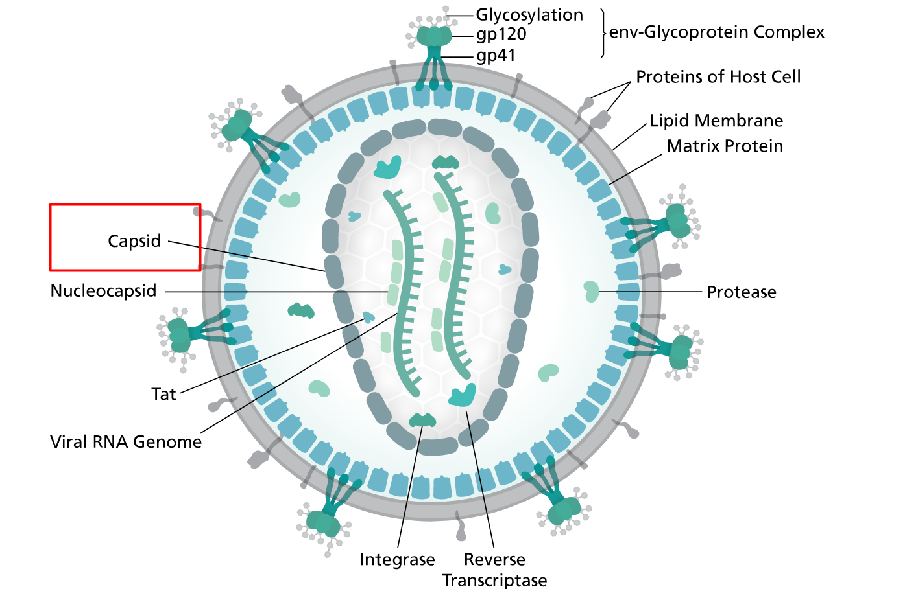
Human Immunodeficiency Virus (HIV)
HIV is a virus that attacks the body’s immune system. There is no cure, but treatments with antiretroviral therapy (ART) can stop further progression of HIV
HIV can be transmitted via bodily fluids
progression: Acute HIV -> chronic HIV -> AIDS
20% of new HIV infections are due to transmission from unaware infected individuals
Circulating RNA and antigen p24 are long recognized as significant biomarkers for HIV-1
Earlier studies suggest antigen p24 is a stronger predictor of progression to acquire AIDS than was RNA. However, proteins cannot be amplified like nucleic acid, which makes it challenging to achieve good sensitivity for p24 detection
Notes:
Human immunodeficiency virus, also known as HIV, attacks a person's immune system and makes them more vulnerable to other infections and diseases.
HIV can be transmitted via bodily fluid. There is no cure for it, but treatments with anti-retro-viral therapy can stop further progression of HIV into AIDS.
Today, 20% of new HIV infections are due to transmission from unaware infected individuals.
Two biomarkers are commonly used for HIV-1 tracking and detection. These are circulating RNA and antigen p24. Antigen p24 is a viral protein that makes up most of the HIV capsid. During HIV infection, p24 is released into the bloodstream where it can be detected.
Previous studies suggest that p24 is stronger than RNA as a predictor to acquiring AIDS. However, the challenge in using p24 as biomarker is that proteins cannot be amplified like nucleic acid, so it is difficult to achieve good sensitivity using p24 as biomarker.

Slide 5
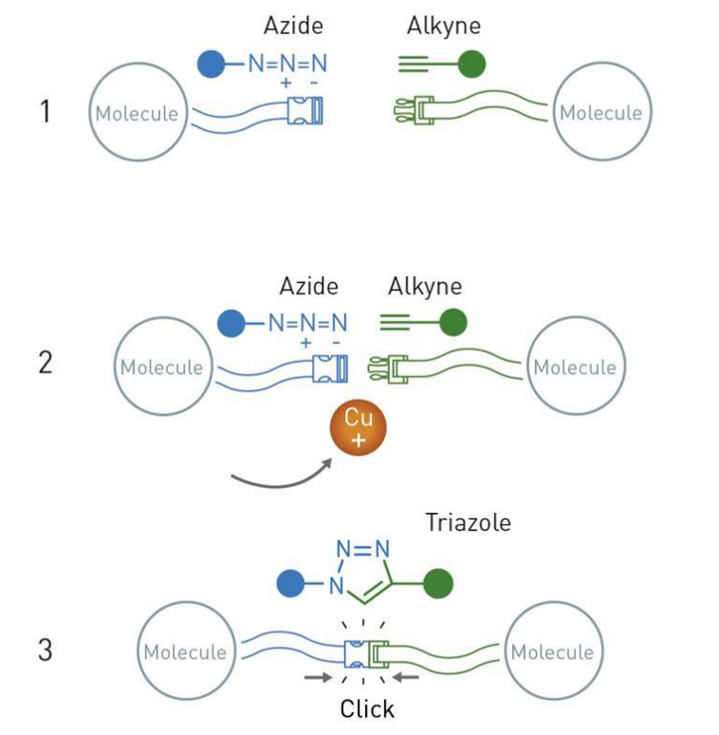
Click Chemistry
Convenient way of doing chemistry
Simple & no waste
Crown jewel of click chemistry: the copper catalyzed azide-alkyne cycloaddition
Widely utilized and reliable way of forming connections between different functional groups
Notes:
A few words on click chemistry. It is basically a convenient way of doing chemistry: simple and virtually no waste.
The crown jewel of click chemistry is the copper catalyzed azide-alkyne cycloaddition shown in the diagram. Because this reaction is so impactful, the scientists who discovered it were awarded a Nobel prize in chemistry last year in October
The assay that I’ll be introducing shortly will be utilizing this kind of azide-alkyne click reaction.

Slide 6
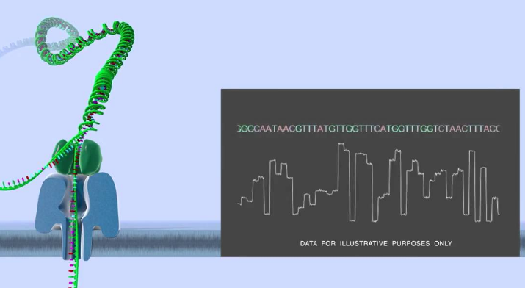
Nanopore
Literally a nano sized pore on a membrane
The pore and membrane can be biological, solid-state, or a hybrid complex of biological and solid-state
Principles
Apply a voltage across the membrane
Induced ion current is measured
Analyte passing through the pore causes current blockade (translocation event) and exhibits a unique signature
Analyte concentration correlate to frequency of translocation events
Challenges
Stochastic in nature, requires at least nanomolar level of analyte concentration to operate practically
Direct application in complex clinical samples with interferent molecules
Notes:
Now let’s talk about nanopores.
A nanopore is literally a nano-scaled opening on a membrane. The pore and membrane can be made from biological, solid-state, or hybrid materials.
In general, how nanopore sensing works is that you apply a voltage across the pore membrane. This induces ionic current to flow through the open channel of the pore and we continuously monitor this current. When single molecules of the analyte passes through the pore, the ionic current is disrupted, and we call this a translocation event. The frequency of translocation events can be used to estimate the concentration of analyte.
Some of the challenges of using nanopore is that the measurements are stochastic in nature which puts a limit on the minimum concentration of analyte for detection. Also, noises from interferent molecules further limits the sensitivity.

Slide 7
Paper
Notes:
That concludes the background, now on to the paper.

Slide 8
Motivations
Lower transmission rates for HIV and improve patient outcomes by extending detection window and monitoring capacity of HIV biomarker assays
Achieved through a lower limit of detection (LOD) and accurate quantification
Existing assays for HIV have either unsatisfactory sensitivity or has not made successful translation through clinical studies
PCR techniques for detecting circulating RNA is costly, time consuming, and does not have significant correlation with host immune parameters, such as infection-fighting CD4 cells, like p24 antigen does
This paper presents a nanopore assay amplified by click chemistry for detection of HIV-1 p24 antigen in clinical samples
Notes:
So there has been high interest in lowering HIV transmission rates and improve patient outcomes by extending detection window and monitoring capabilities of HIV assays.
Current existing HIV assays have either unsatisfactory sensitivity or has not made successful translation through clinical studies.
PCR based techniques for detection RNA is costly, timing consuming, and does not correlate strongly with host immune parameters like p24 antigen does.
To address these issues, this paper presents a nanopore assay amplified by click chemistry for detection of HIV-1 p24 antigen in clinical samples.

Slide 9
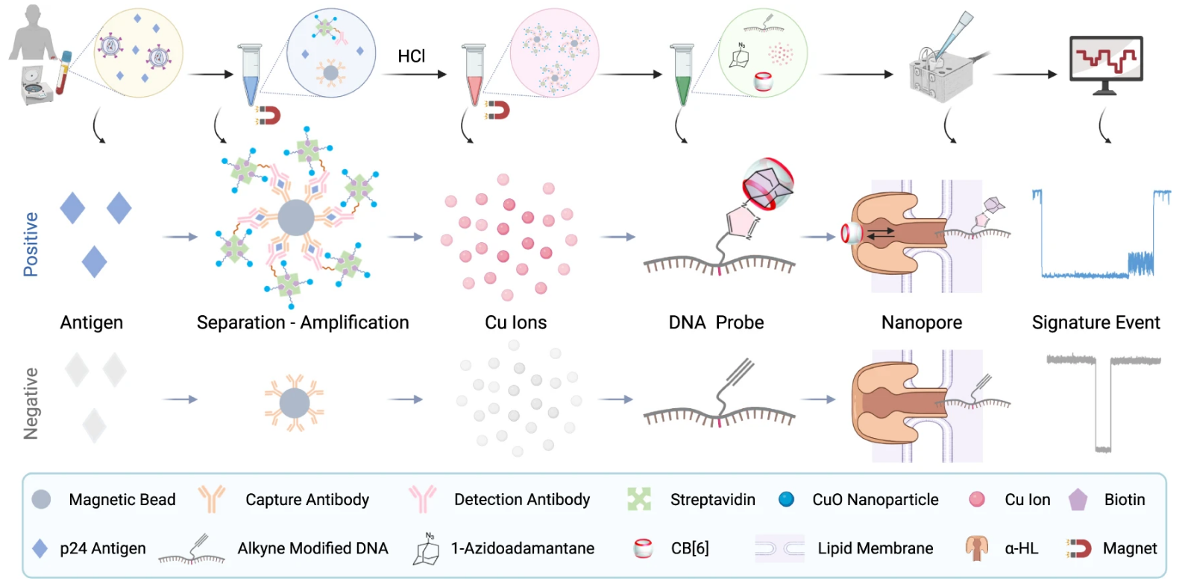
Click Chemistry Amplified Nanopore (CAN) Assay Workflow
Notes:
Here’s the overview of the assay workflow. Both positive and negative detection scenarios are presented, but let’s just look at the positive scenario here.
First, human serum was extracted from blood samples then incubated with capture antibody-modified magnetic beads (MBs) and detection antibody-modified copper oxide nanoparticles (CuONPs) to form a sandwich structure with p24 antigen in the middle of the sandwich.
Then, the sandwich complexes were magnetically separated, and copper ions were released under acidic conditions. (sodium ascorbate reduction of Cu²⁺ ions)
DNA probes were then formed under click reaction catalyzed by the copper ions. In details, the click reaction joins the Azido-adamantane with the alkyne modified DNA. After the click reaction, the DNA adamantane structure was incubated with CB[6] to allow host-guest reaction between adamantane and CB[6] to form the final structure of the DNA probe.
Lastly, the DNA probes were collected and sent to the nanopore system for measurements. The rate of the signature events are used to determine concentration of p24 antigen

Slide 10
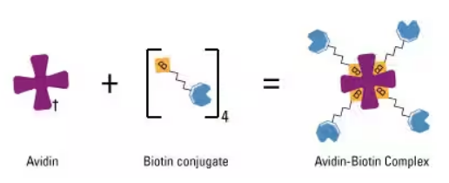
CAN Assay Overview
LOD of 20.8 fM (0.5 pg/mL) for p24 detection in human serum
40~100-fold higher analytical sensitivity than a fluorescent copper nanoclusters (CuNCs) assay
20-fold higher analytical sensitivity than a clinically used benchmark ELISA
Selectivity due to multi-level translocation signal that is clearly different from translocation signatures of other molecules
High sensitivity due to amplification by click chemistry & biotin-avidin binding
Notes:
Here’s some key points about the CAN assay.
The LOD for p24 antigen is 20.8 fM in human serum. Its sensitivity is 20 times higher than clinically used benchmark ELISA and up to 100 times higher than a copper nanocluster assay, which uses a similar sandwich structure for detection but is fluorescent based.
The selectivity of the CAN assay comes from a unique multi-level translocation signature that is clearly different from signatures of other molecules.
The high sensitivity of the assay is due to the amplification by click chemistry and biotin-avidin binding which is shown in the figure here. This allows you to amplify some quantity by factor of four.

Slide 11
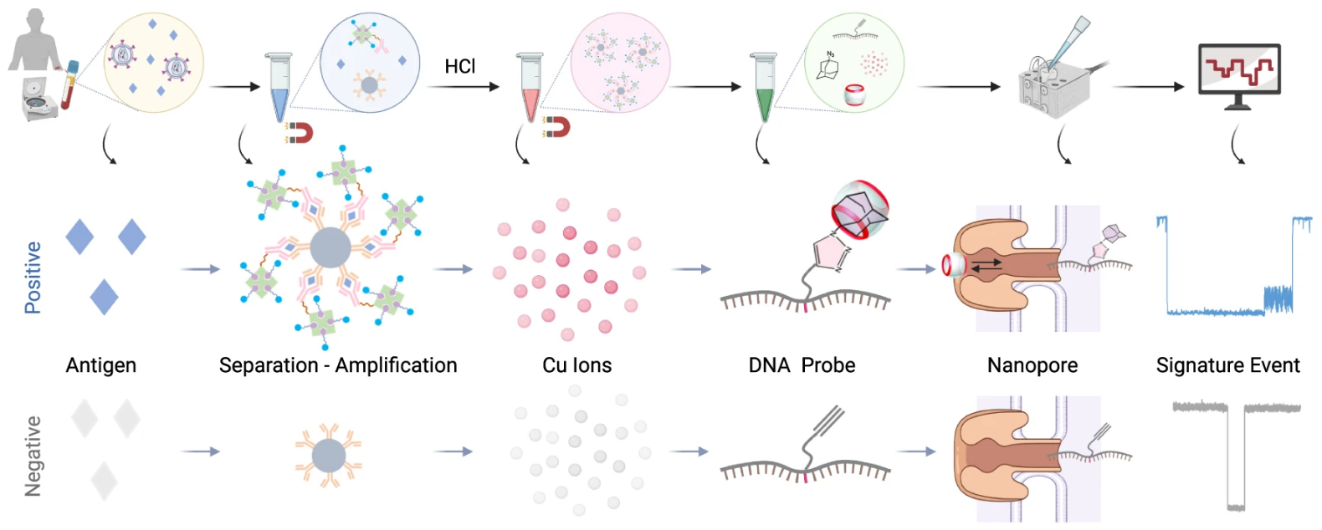
Paper Subtopics
Nanopore Characterization and Translocation Behaviors of DNA Probes
Cu+ Ion Concentration Dependent Catalytic Click Reaction
Optimization of the CAN Assay
Analytical Performance Benchmarking
CAN Assay Clinical Validation in a Pilot Cohort
Notes:
The following sections of the paper are organized in this manner.
We will basically work our way backwards in the assay workflow diagram, starting with characterizing the nanopore system, followed by the copper ion catalyzed click reaction, and finally discuss the amplification step.
Last two sections are on comparisons to other sensing methods and clinical experiments.

Slide 12
Nanopore Characterization and Translocation Behaviors of DNA Probes

Slide 13
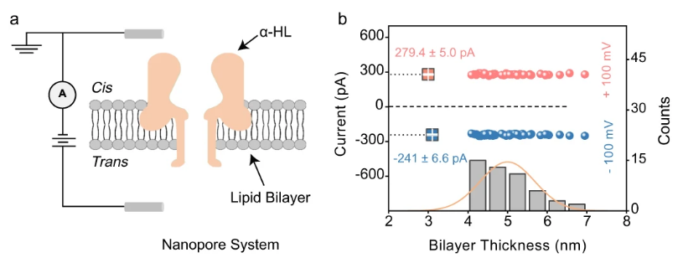
Nanopore Characterization
Ensure proper operations of the nanopore
Notes:
To ensure that the nanopore will operate properly, positive and negative voltages were applied to the trans side of open channel nanopore with cis side grounded.
A properly inserted α-hemolysin pore is characterized by larger ionic current under a positive trans voltage than it is under a negative trans voltage. This is indeed observed in figure b.
Also, the suitable thickness of a bilayer membrane for insertion is ~5 nm, corresponding to 160-180 pF capacitance. Measurements in figure b show that thickness distribution roughly centers around 5nm.
These nanopore characterizations show that nanopore system is properly setup.

Slide 14
Translocation Behaviors of DNA Probes
Characterizing multiple phases of the DNA probe
alkyne modified DNA
Sequence: 5’-CCCCCCCCCCT*CCCCCCCCCC-3’, T* indicates alkyne-modified thymine
DNA-1-Azidoadamantane (DNA-AA)
Obtained via click reaction between alkyne modified DNA & 1-Azidoadamantane (AA) in presence of copper ion catalyst
DNA-AA@cucurbit[6]uril hydrate (DNA-AA@CB[6])
Obtaiend via host-guest reaction between DNA-AA and CB[6]
Notes:
Difference phases of the DNA probes were also characterized to understand the raw current measurements from the nanopore system.
We first have the alkyne modified DNA, purchased from vendor.
Then, through click reaction between alkyne and azido, DNA-Adamantane was formed, and this process takes ~4 hours
Finally, DNA-Adamantane is incubated with CB[6] to form DNA-Adamantane-CB[6] (DNA-AA@CB[6]) complex, which also takes ~4 hours
-----------------------------
Note that in the workflow of the assay, DNA-AA formation is dependent on the analyte concentration responsible for producing the copper ions for the click reaction. So, these time-consuming steps are part of the whole assay procedure.

Slide 15
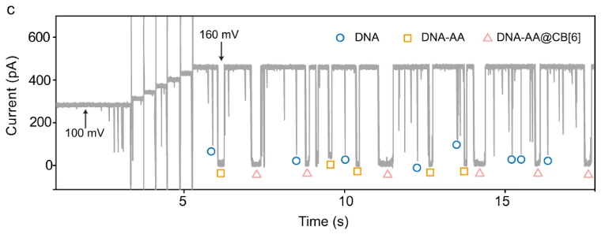
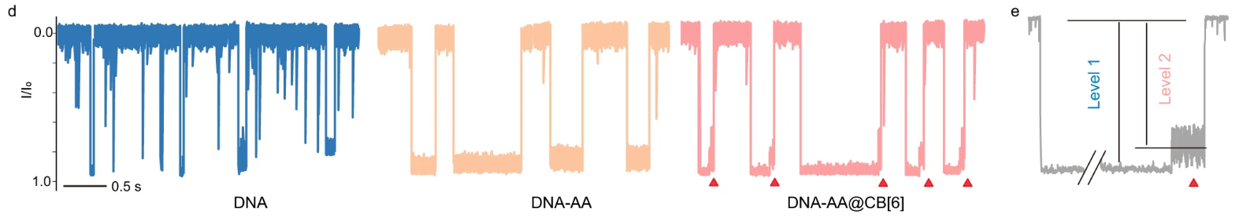
Translocation Behaviors of DNA Probes (Cont.)
Notes:
Figure c shows the raw current traces of the nanopore system. Different signatures of the DNA probes are marked.
Figure d shows the current traces for each phase of DNA probe in details. Each signature can be characterized by current magnitude and duration.
For DNA and DNA-Adamantane, the signature differences is clearly seen. DNA-Adamantane has longer dwell time and slightly stronger current blockade levels.
For DNA-Adamantane-CB[6] complex, its signature is similar to DNA-Adamantane but what is unique about it is that there is a second level of current blockade following the first level signature. This is seen more clearly in figure e. The level 1 signal is due to DNA backbone translocation, level 2 is due to CB[6] oscillation after it dissociates from the DNA probe and becomes temporarily struck in the nanopore vestibule. To reiterate again, the significance of multi-level signature ensures highly specific detection.

Slide 16
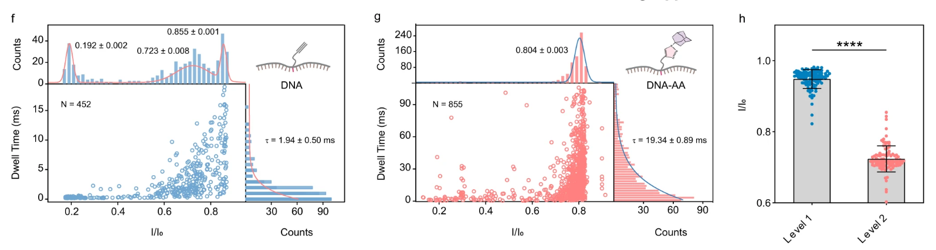
Quantitative Analysis of Translocation Events
Notes:
Further quantitative analysis were done on translocation events for DNA and DNA-Adamantane.
Graphs f and g are 2 dimensional graphs showing current blockage and dwell time profile.
You can see that in figure f for DNA, current blockade centers around 0.855. The other peaks, explained by the authors, may be due to background noise and random DNA collision with the nanopore.
Figure g for DNA-Adamantane has a similar blockage profile, but without non-specific peaks. However, mean dwell time for DNA-Adamantane significantly increased by 10-fold.
DNA-Adamantane-CB[6] complex did not further change the current blockade and dwell time profile, but this structure causes a two-level translocation signal as discussed previously. This is quantified in figure h, where the authors performed a statistical test call unpaired two-samples t-test, which tests if the means of samples are the same. The test found that the p value was less than 0.0001, which suggests that the difference between the mean is likely not due to chance. In other words, there is significant separation between each level of the signature.

Slide 17
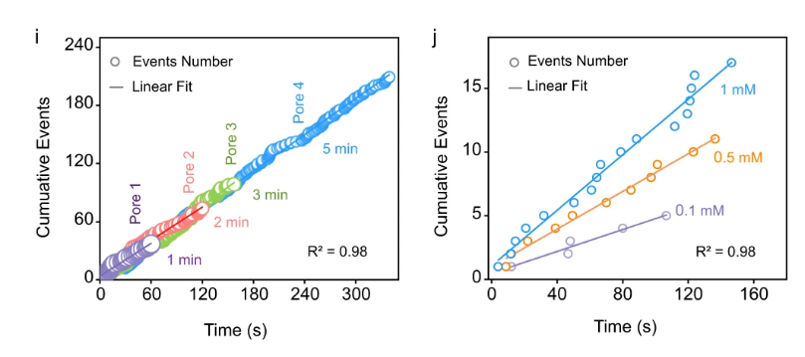
Capture Rate Study on DNA-AA@CB[6]
Notes:
Capture rate study was done on the translocation events induced by DNA-Adamantane-CB[6]
This kind of study helps us to understand how the signal of interest varies based on various parameters such as capture time, operating voltage, and copper ion concentrations.
It also tells us how much variations exist across different nanopores.
Figure i shows the cumulative capture events over different recording times and across four different nanopores. Clearly, we can see a consistent slope, or capture rate, across all the measurements.
Similarly in figure j, we have the cumulative events over time for various copper ion concentrations. You see a positive correlation with the copper ion concentration here, this is because higher amount of copper ion catalyst causes more DNA-Adamantane to be formed, so naturally you would expect more signature events to occur.

Slide 18
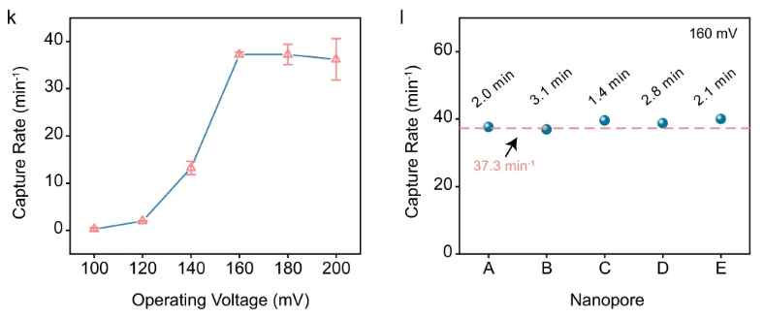
Capture Rate Study (Cont.)
Notes:
Figure k shows the capture rate as operating voltage is varied.
Capture rate increases with operating voltage. This is because higher positive voltage promotes dissociation of CB[6] from the DNA probe and reduces the possibility of DNA escaping back to the cis side of the nanopore membrane.
However, high voltage can also destabilize the membrane, which explains the increased variations at high operating voltages.
Based on the capture rate studies, the authors picked the optimal parameters of 160 mV and around 2-minute recording time.
Figure l shows repeated experiments done under optimal parameters. This is just to highlight the consistency and reliability of the sensing.
--------------------------------------------------
Capture rate also depends on electrochemical environment of the nanopore system.
Optimal multi-level signal frequency can only be achieved using balanced cis and trans work solutions.
In other words, same electrolyte concentrations and pH levels on both cis and trans side

Slide 19
Cu+ Ion Concentration Dependent Catalytic Click Reaction
Notes:
Now we will take a look at the click reaction in the assay

Slide 20
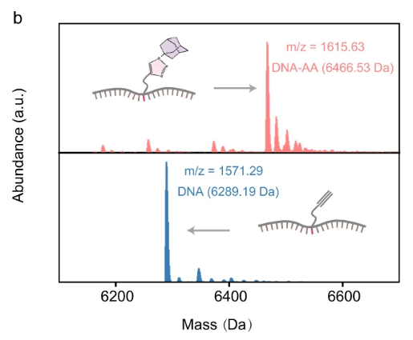
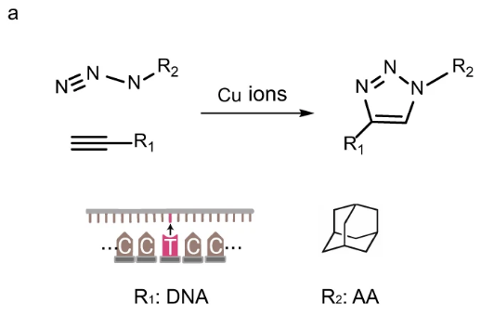
Cu+ Ion Concentration Dependent Catalytic Click Reaction
Study the impact of Cu+ ion concentration and reaction time on the click reaction between azide and alkyne (DNA => DNA-AA)
Notes:
The click reaction is described in figure a between alkyne and azide to connect the DNA with adamantane.
Figure b shows the mass spectrometry of the DNA probe before and after the click reaction.
It is important to notice that the peak in the mass spectrum shifts right when the click reaction is successfully carried out and products are formed.

Slide 21
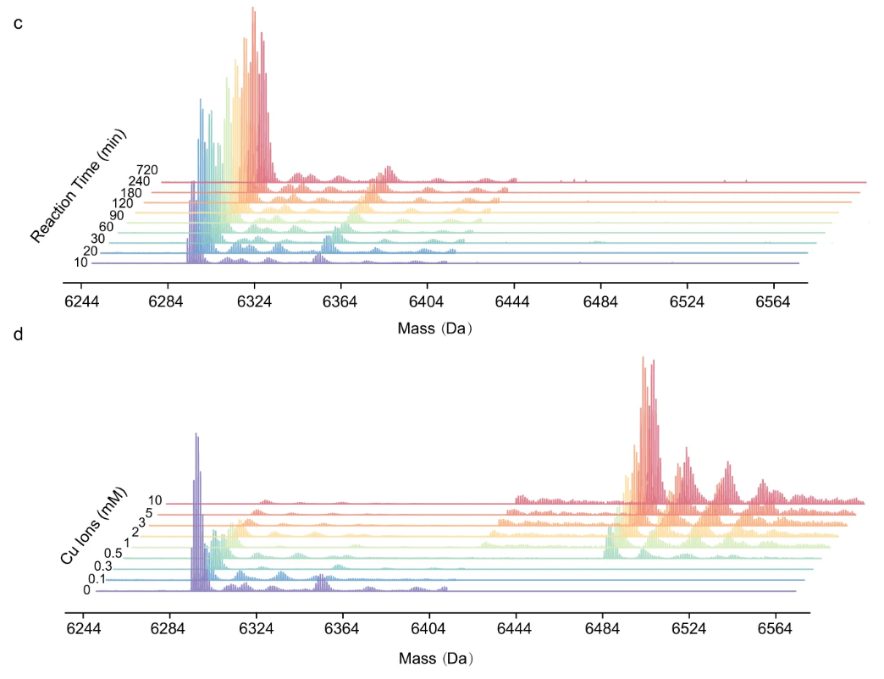
Mass Spectrometry Measurements of Click Reaction
Notes:
Figure c shows mass spectrometry measurements of click reaction under zero copper ion concentration plotted against reaction time. We can see that the peaks in the spectrum does not shift at all, meaning that click reaction does not proceed in the absence of copper ion catalyst.
In the presence of copper ions however, the click reaction does move forward. This is seen in figure d. A higher concentration of copper ion causes more shift to higher spectrum, so more DNA-Adamantane probes are formed.

Slide 22
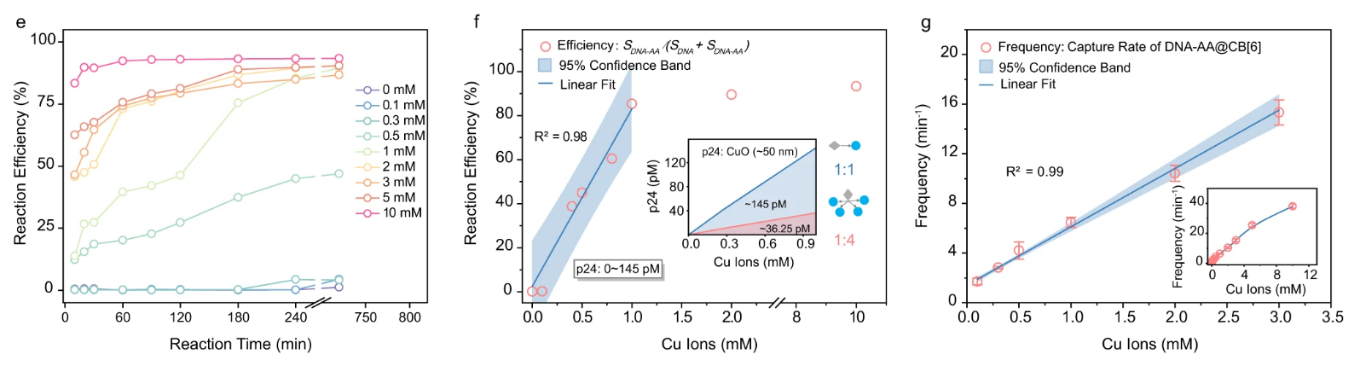
Reaction Efficiency and Relations to Capture Rate
Reaction efficiency is determined by S_{DNA-AA}/(S_{DNA} + S_{DNA-AA}) (S: integrated peak area in mass spectrum)
P24 antigen concentration in most clinical scenarios: 0.42-33.3 pM
Notes:
Further kinetic study shows that the yield, or reaction efficiency, positively correlate with reaction time and copper ion concentration.
Graph e shows the efficiency as function of reaction time and also shows how efficiency varies for different concentrations of copper ion. You can see that efficiency plateaus around 240 minutes (4 hours), and this was the optimal reaction time selected for the assay.
Graph f shows efficiency as function of copper ion concentration. Efficiency saturates at 10 mM of copper ions, but there’s a good linear relationship from 0 to 1 mM, which corresponds to approximately 0-36.25 pM of p24 antigen under 1:4 amplification ratio. Which covers the dynamic range for most clinical scenarios.
Graph g shows that the copper ion concentration has an excellent linear relation to capture rate for the range of interest and beyond.

Slide 23
Optimization of the CAN Assay
Notes:
Now let’s look at the amplification step.

Slide 24
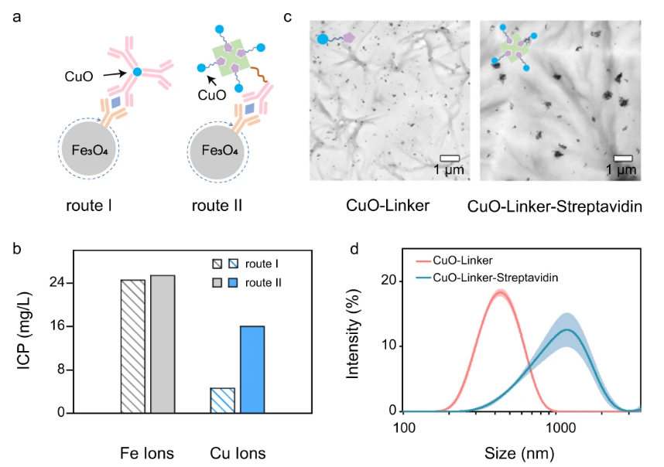
Compare Different Sandwich Structures
Notes:
The paper evaluated two sandwich structures with different p24 antigen to copper oxide nanoparticle ratios. Route 1 has a 1:1 ratio and route 2 has a 1:4 ratio.
Figure b shows copper ion quantification by plasma-optical emission spectroscopy (ICP-OES), which showed that route 2 contained around 4 times the amount of copper ions compared to route 1 with similar amount of iron ions.
Figure c show transmission electron microscopy (TEM) of the two routes and figure d shows dynamic light scattering (DLS) results which tells you about size distribution of the particles.

Slide 25
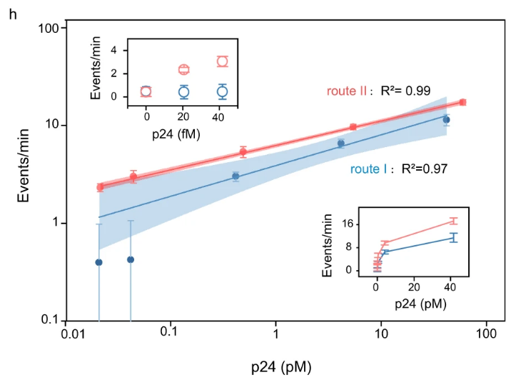
Calibration Curve
Further evaluation of LOD following EP17 protocol
LOB = mean_{blank} + 1.645(SD_{blank}), LOD = LOB + 1.645(SD_{low concentration sample})
Calculated LOD = 18.3 fM (0.44pg/mL)
Notes:
Calibration curves were established for route 1 and route 2. Tests were done with human sera spiked with various amount of p24 antigens
Route 2 shows greatly improved detection accuracy and reproducibility, especially in the low concentration range.
Route 2 LOD is said to be approximately 20-fold lower than route I
Further validation for the LOD of route 2 is established following EP17 protocol, which is published by the Clinical and Laboratory Standards Institute (CLSI).
The calculated LOD of 18.3 fM is very close to the LOD claimed by the authors, which is 20.8 fM.

Slide 26
Analytical Performance Benchmarking
Notes:
Now we take a look at the benchmarking of the assay

Slide 27
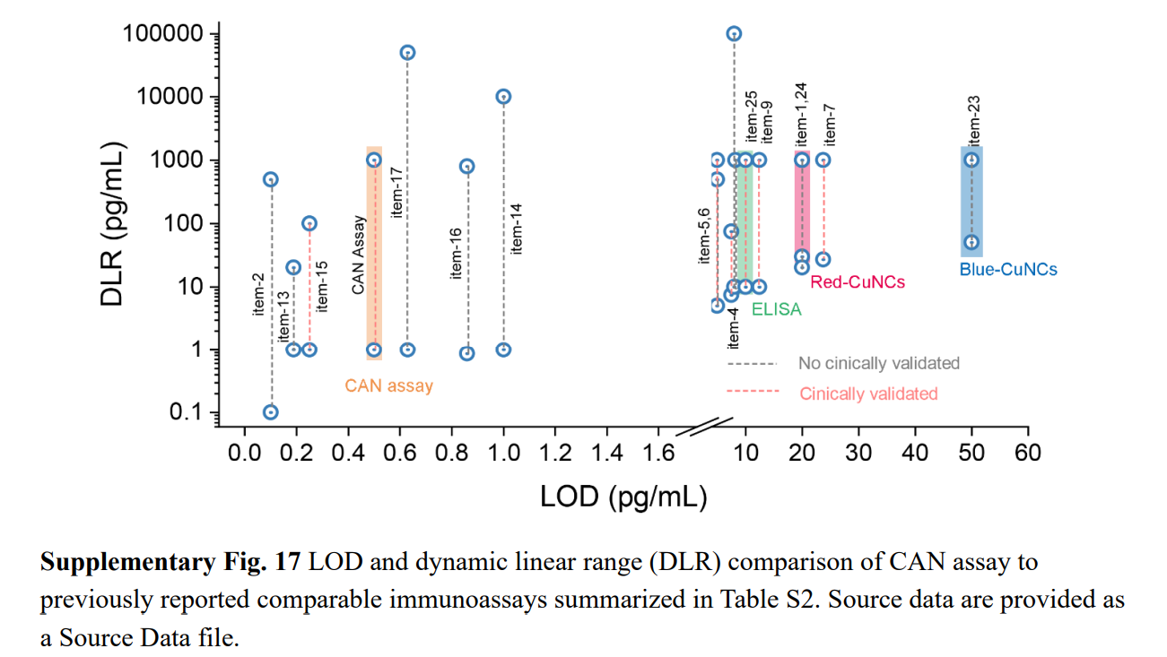
Comparing the CAN Assay to Other Immunoassays
Notes:
The results from benchmarking can be summarized in one graph here comparing the LOD and dynamic range of the CAN assay with several other HIV immunoassays.
While the CAN assay does not have the lowest LOD or biggest dynamic range over all the comparisons, but if you only consider clinically validated assays, the CAN assay arguably is the best overall.
Notably, you can see that the CAN assay has a lower LOD and bigger dynamic range compared to commercialized ELISA HIV test kit.

Slide 28
CAN Assay Clinical Validation in a Pilot Cohort
Notes:
Last section of the paper talks about clinical validation

Slide 29
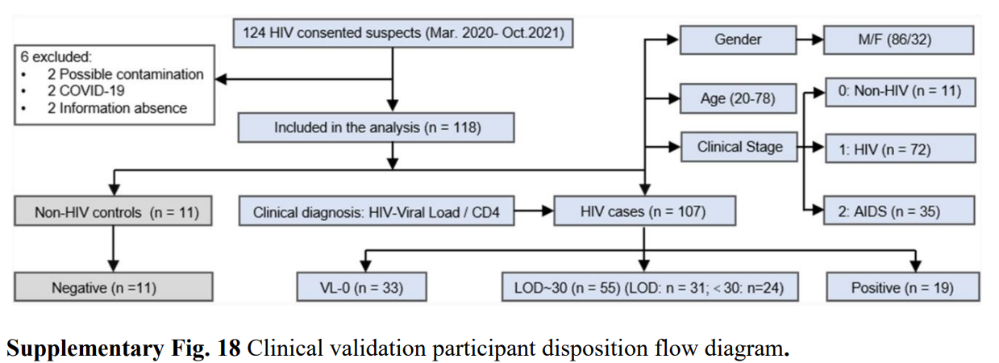
Clinical Testing
Notes:
For clinical testing, 124 human samples were collected, 6 were excluded for various reasons. The ELISA based 4th generation HIV test kit was used as reference.
The samples were divided into four sample groups
Negative samples
VL-0 samples with undetectable viral load
LOD~30 samples with viral load between LOD and 30 copies/mL
Positive samples with >30 copies/mL viral load

Slide 30
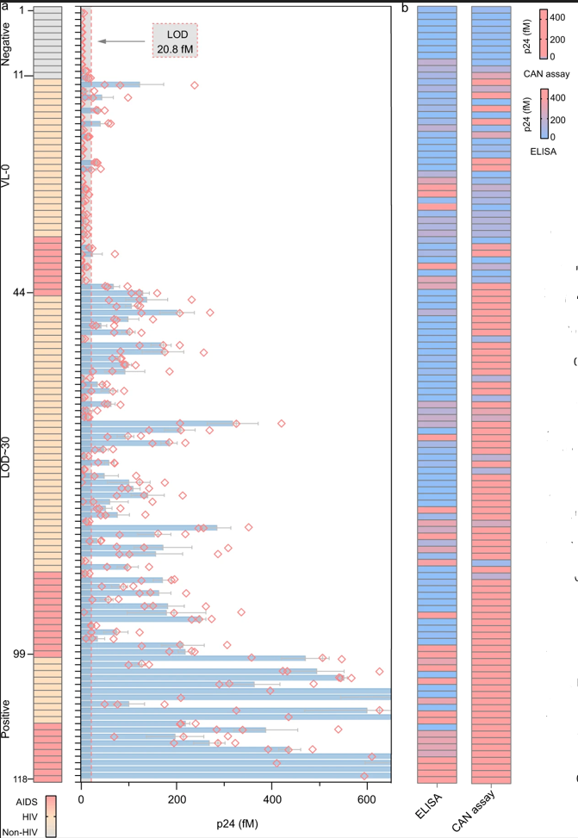
CAN Assay Results
Notes:
Test results for the CAN assay is summarized here.
In the top diagram, each bar represents one sample. Each red diamonds is one experiment, and the authors did 3 experiments per sample. The blue bars indicate the mean measurements for each sample.
The bottom diagram compares the test results for ELISA and CAN assay side by side. You can see that CAN and ELISA are generally consistent on the negative samples, but CAN assay shows superior sensitivity in VL-0 and LOD~30 group. For the positive cases, ELISA actually tested negative for a several samples.

Slide 31
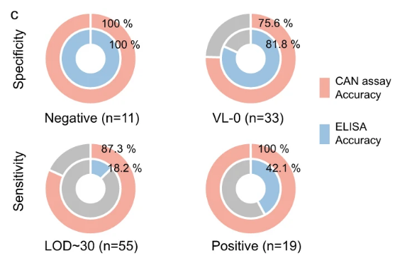
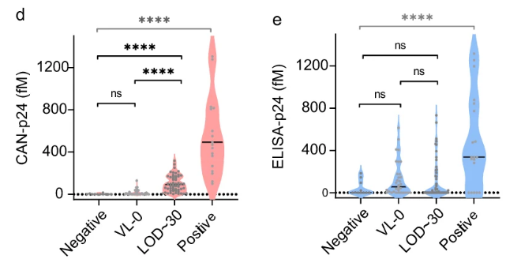
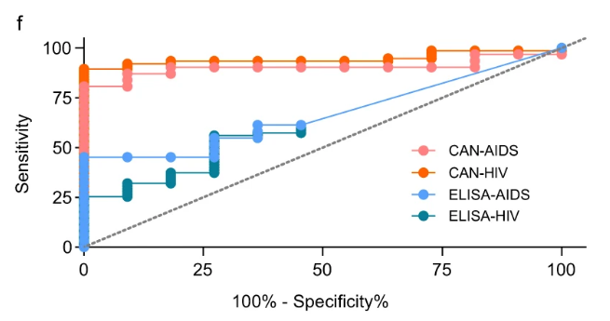
Statistical Analysis on Test Results
Notes:
Here’s the statistical analysis comparing ELISA and CAN assay.
In figure c, we see that the CAN assay is much better in sensitivity in samples with detectable viral load.
Figures d and e show the mean level of p24 antigen for each sample group for the CAN assay and ELISA. Post-hoc Tukey tests were done on the mean values to test if mean values are similar or dissimilar.
“ns” means no significance in comparison, “****” means statistical significance in comparison. We see that ELISE was only able to detect significantly higher p24 in positive samples with high viral load while CAN assay detects differences between LOD~30 samples and samples with undetectable viral loads. Results demonstrate quantification capability of the CAN assay for potential prognostic uses.
Figure f shows the ROC curve, where you compare areas under the curve. It just shows again that the CAN assay is better than ELISA test kit.

Slide 32
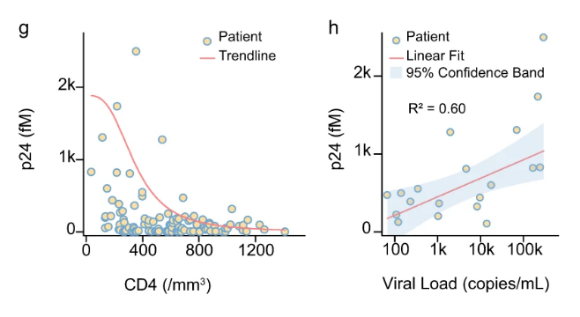
P24 Antigen Correlation with CD-4 and Viral Load
Notes:
Finally, the measured p24 antigen concentration detected using CAN assay was plotted against CD-4 count and viral load.
From graph g, you can see that patients who are severely immunocompromised or has a CD-4 count of less than 200 has significantly higher p24 antigen concentration compared to normal CD-4 count, which is anything above 500
There is also a positive correlation between p24 antigen levels and viral load seen in figure h.
These extrapolated correlations are consistent with findings in previous reports.

Slide 33
Paper Conclusion
Demonstrated quantification of p24 antigen in clinical samples at ultra-low concentrations and superiority over commercialized ELISA HIV-1 test kit
Demonstrated CAN assay reliability in correlation with CD-4 count and viral load results
Future work
Larger cohort study for early HIV-1 diagnosis and prognosis
Assay automation and cost reductions
Improve sensitivity by applying higher voltages or reducing blood interferents
Improve analyte to DNA probe ratio
Could be modified to detect other biomarkers
Notes:
In conclusion, the paper demonstrated quantification of p24 antigen in clinical samples at ulta-low concentrations using the assay they developed. It also demonstrated that their assay was superior in sensitivity compared to commercialized ELISA HIV test kit.
Reliability of their assay was demonstrated in correlation with CD-4 count and viral load.
Some of the future work outlined by the authors are:
Using larger cohort study for early HIV diagnosis and prognosis
Reducing cost and time for the assay through automation
Improving sensitivity by applying higher voltages, reducing blood interferents, and increasing the amplification ratio of target to probe
Assay can be modified to detect other biomarkers

Slide 34
Opinions
Notes:
On to my opinons

Slide 35
PROS
Paper is heavy on characterization studies
The novelty of the paper is in the copper ion delivery system where each captured analyte yield 4 copper ions instead of 1
Graphs are properly labeled, easy to interpret, coloring is generally consistent
Detection mechanism diagram shows both positive and negative detection scenarios, which is very informative
Probe system is decoupled to the analyte capturing mechanism using copper ions as the medium, which makes the assay flexible

Slide 36
CONS
Nothing said about significance of DNA sequence used or why the linking happens at middle position of sequence
5’-CCCCCCCCCCT*CCCCCCCCCC-3’, T* indicates alkyne-modified thymine
Not sure how specificity is calculated in Fig 5.c
Does not have high level system diagram of the assay structure
Unclear if assay uses single nanopore or a matrix of nanopores for detection
For benchmarking comparison, only looked at LOD, dynamic range, and if the assay is clinically validated
Could include more details on advantages/disadvantages of each method, turn-around-time, cost, etc.
Notes:
My speculations for this sequence is that having the same nucleobases avoids fluctuating current measurements and they used cytosine because it has a stronger charge relative to other nucleobases. But I dunno why the modification is placed in the middle position and why this particular length of sequence is chosen.

Slide 37
FUTURE WORK
Explore using different nanopores and membranes
Explore different probe structures
Probe system theoretically could be anything that can click together using azide-alkyne cycloaddition
Potential improvements:
Further levels of translocation signature, better sensitivity & selectivity
Reduce turn-around-time for probe synthesis, which took significant amount of time in CAN assay

